Slide 1

Employee Management System Project Supervisor: DR.R.Sathyabama Krishna Name of the Student: D.Sai Pranay Register Number: 39110264

Slide 2
Presentation outline:
Course Certificate
Introduction
Objectives
System Architecture / Ideation Map
Module Implementation
Application Snapshots
Results
Conclusion & Future work
References

Slide 3
Course Certificate

Slide 4
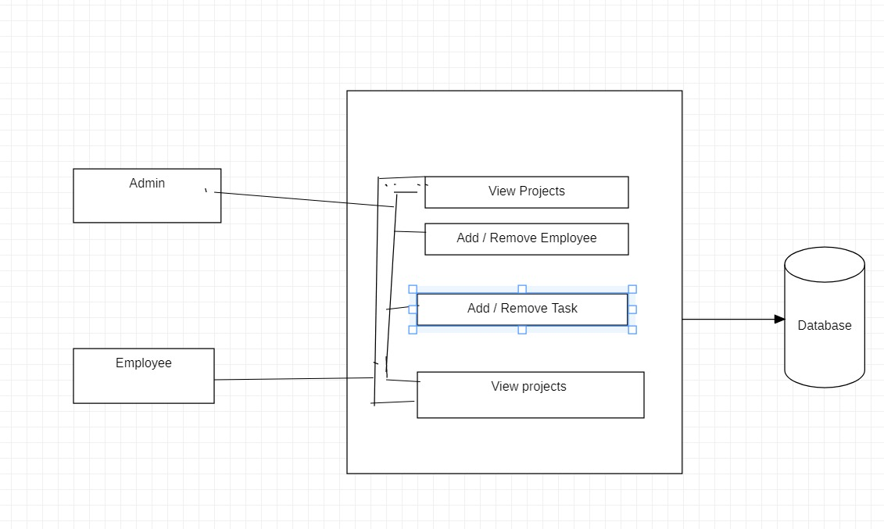
System Architecture :-

Slide 5
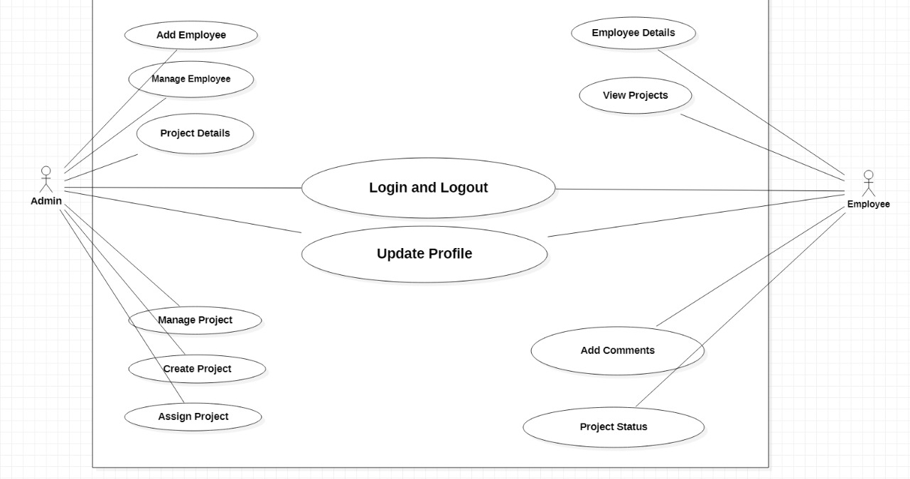
Ideation Map:-

Slide 6
Introduction
The application that are building is Employee management system. It has features to Add employee and add task.
Admin can create task and he can also create employees.
The created employees can view their tasks assigned by the employee.
The admin can also delete the tasks assigned to employees
The application will be widely used in the organizations which are looking to manage their employees and their tasks assigned. Also, to understand the work statuses of their employees

Slide 7
Architecture
The Architecture that we are following has three components. Which are as follows:
. Front End
. Back End
. Database

Slide 8
Software Used
Reason for following is, in case we want to scale the existing application it would make our job easier to aggregate our features into the desired component.
The technology stack is as follows:
Front end - React JS, Html and Css
Backend - python Flask
Database - MySql

Slide 9
Reasons for the using above software
For the front end we are using React, the reason being its flexibility to reuse the components. We declare the components which can be further used in various parts of the application.
For example,
The component of employee listing can be reused for the projects listing. So, react js gives us the flexibility for reusing the components.
For the Backend, we are opting for the Python-Flask. Flask is a micro framework which is built on python. Flask framework is suitable for applications which has short and crisp versions of components. Although we are using DB efficiently, API calls are limited. So flask is optimal for such cases.

Slide 10
The Micro service Architecture
As we are running each component,
Python flask
React Js
MySql
Into different ports,
Flask is running on 5000,
React Js on 3000 and mySql on 3306.
We can consider the above Architecture as a microservice Architecture.

Slide 11
Further Analysis
Having said that, Netflix is also using Flask for a few components in their Application like subscription service of their platform has flask involved in it. Its also easy to use too.
For the Database we are using, MySql. As we are dealing with employee status management we want to make use of database for most write operations. So MySql is handy for such cases and writes immensly faster.

Slide 12
Pros of MicroService
• Easy to destruct
• easy to debug
• logging
• scalability

Slide 13
Cons of MicroService
Microservices has all the associated complexities of the distributed system.
There is a higher chance of failure during communication between different services.
Difficult to manage a large number of services.
The developer needs to solve the problem, such as network latency and load balancing.
Complex testing over a distributed environment.

Slide 14
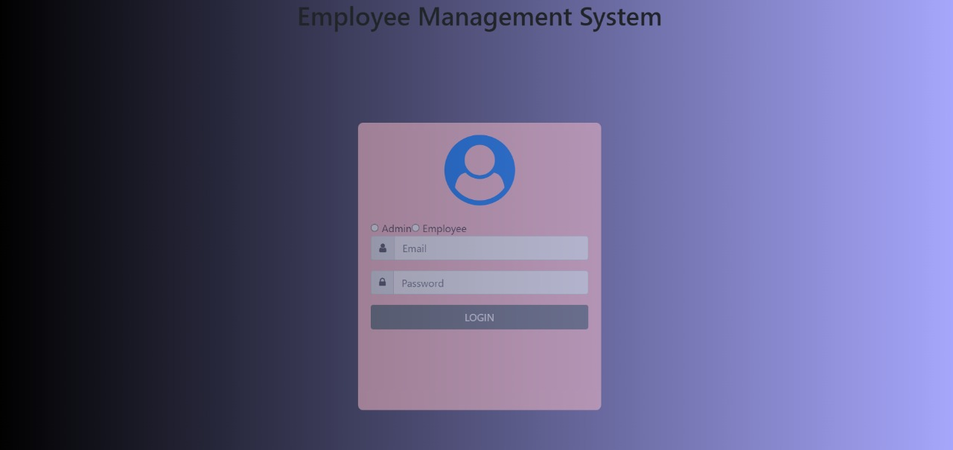
Application Screen shots
Login page:-

Slide 15
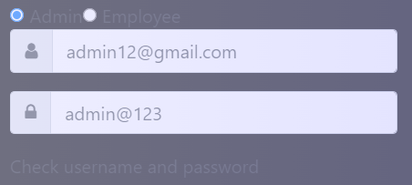
Wrong Credentials:-

Slide 16
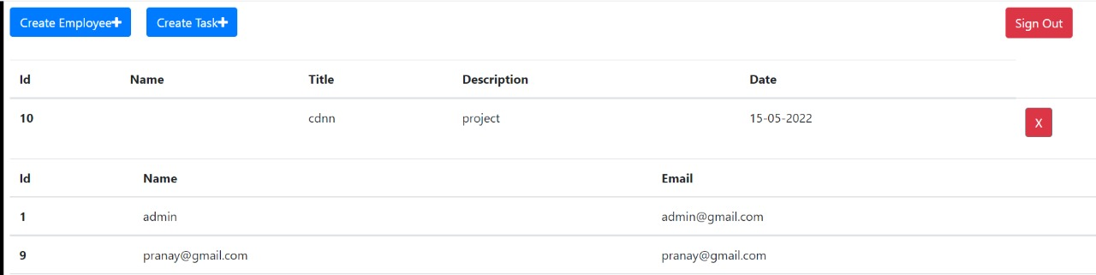
Admin Page:-

Slide 17
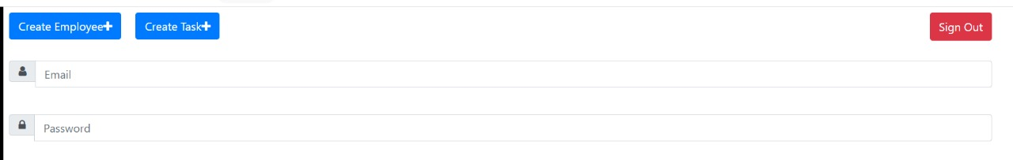
Create Employee:-

Slide 18
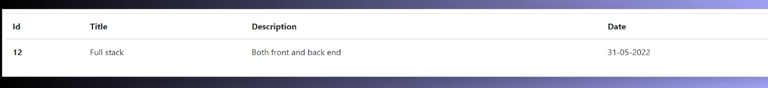
Assigning Project:-

Slide 19
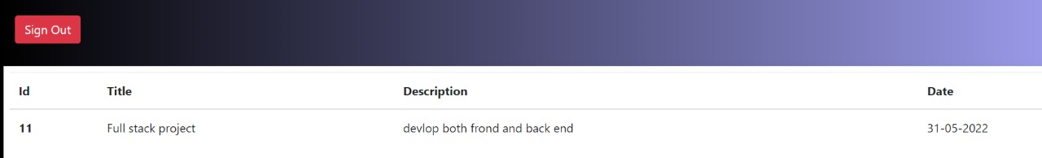
Employee page:-

Slide 20
Conclusion:-
AS a part of this project, i would like to conclude that i have leant a lot about building full stack applications. I have also understood how the communication between different components of an application happens. As per ,The Employee management system , i have gone through a lot of applications for approaches. I have researched alot in the similar domain.

Slide 21
Github link:-
https://github.com/saipranay9889/Employee-Management-System.git

